Slide 1


History of Selenium

Slide 2


What is ?
is an open Source Test Automation Tool for Testing Web Applications

Slide 3

Why Selenium?

Slide 4

Father of Selenium Core
In 2004 Jason Huggins @ ThoughtWorks while testing web application related to time and expenses found some repetitive tasks and to test it he developed a JavaScript Program which performed Automation of repetitive tasks
Officially selenium was released i.e “selenium Core” by the end of 2004

Slide 5
Selenium Core
Application
Web Server
JavaScript
TestRunner
Application
Under Test

Slide 6
Same Origin
https://www.google.com:443/search

Slide 7

Same Origin Policy
JavaScript of one domain cannot access JavaScript of another domain
www.google.com
www.facebook.com

Slide 8

Father of Selenium RC
In 2006 Paul Hammont developed Selenium RC due to the drawback of
Selenium Core

Slide 9



Selenium RC Architecture
Selenium Core
Selenium Core
Selenium Core
Selenium Remote Control
Automation Scripts

Slide 10


Father of Selenium Grid
In 2007 Patrick Lightbody developed Hosted QA which performs Parallel Execution

Slide 11

Father of Selenium IDE
In 2007 Shinya Kasatani in Japan became interested in Selenium, and realised that he could wrap the core code into an IDE module into the Firefox browser, and be able to record tests as well as play them back in the same plugin.

Slide 12
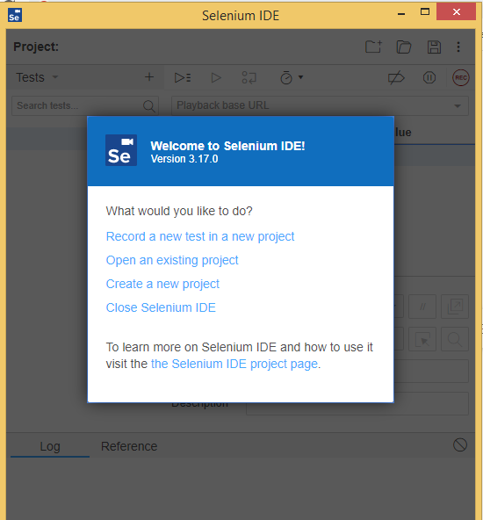
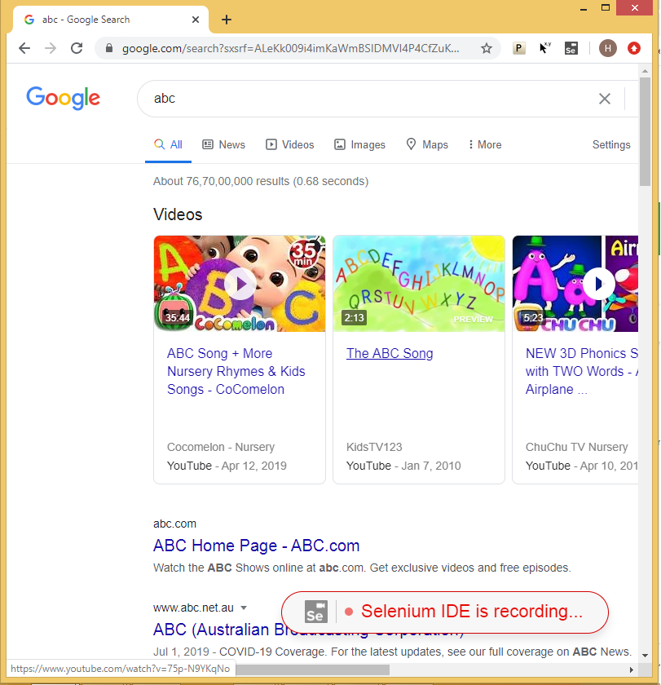
Selenium IDE – Record and Playback

Slide 13
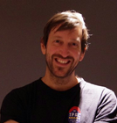
Father of Selenium WebDriver
In 2009 Selenium WebDriver was release by Simon Stewart to avoid the drawback of Selenium RC

Slide 14
Current Versions and Future Versions of Selenium
Versions | Selenium Core | Selenium RC | WebDriver | W3C WebDriver
Selenium | Selenium Core
Selenium 1.0 | Selenium Core | Selenium RC
Selenium 2.0 |  | Selenium RC | WebDriver
Selenium 3.0 |  |  | Only WebDriver
Selenium 4.0 |  |  | WebDriver | W3C WebDriver
Selenium 5.0 |  |  |  | Only W3C WebDriver

Slide 15
Selenium Developers of each versions
Selenium Versions | Developers | Official Release Dates
Selenium Core | Jason Huggins | 2004
Selenium RC | Paul Hammont & Patrik LightBody | 2006
WebDriver | Simon Stewart | 2011 and 2016
Other Components of Selenium
Names | Developers | Official Release Dates
Selenium IDE | Shinya Kasatani | 2006
Selenium Grid | Paul Hammont & Patrik LightBody | 2007

